Slide 1
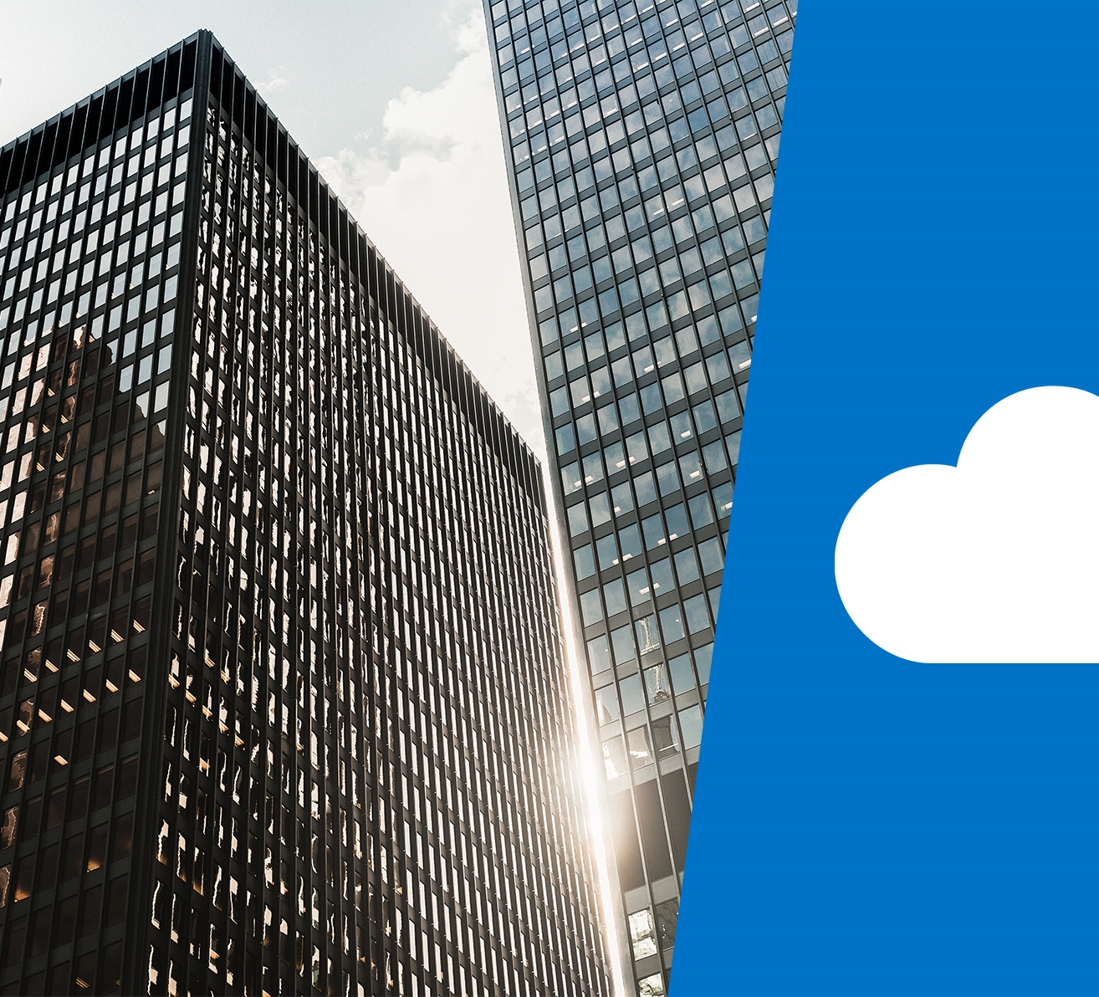
DP-201T05: Designing for Scale and Resiliency

Slide 2
Lesson Objectives
Scaling Systems
Optimizing Network Performance
Optimizing Storage Performance
Identifying Performance Bottlenecks
High Availability
Disaster Recovery
Backup and Restore

Slide 3
Scaling Systems
Scaling up or down
Scaling up or down is the process where we increase or decrease the capacity of a given instance. It adjusts the amount of resources a single instance has available. You can use autoscaling so that this can be managed automatically
Serverless Computing.
Containers
A container is a method running applications in a virtualized environment. The virtualization is done at the OS level, making it possible to run multiple identical application instances within the same OS.
Azure Kubernetes Service (AKS)
Azure Kubernetes Service allows you to set up virtual machines to act as your nodes. Azure hosts the Kubernetes management plane and only bills for the running worker nodes that host your containers.
Azure Container Instance (ACI)
Azure Container Instances is a serverless approach that lets you create and execute containers on demand. You're charged only for the execution time per second.
Scaling in or out
Scaling out is the process of adding more instances to support the load of your solution. Scaling in is the process of removing instances that are no longer needed.
.
Notes:
“Resources” can refer to anything we need to manage to run our applications. Memory and CPU for virtual machines are the most obvious resources, but some Azure services might require you to consider bandwidth or abstractions, like Cosmos DB Request Units, or SQL Date Warehouse Units.
Scaling is difficult in an on-premises scenario, where you purchase and manage your own servers. Adding resources can be costly and often takes too much time to bring online, sometimes longer than your actual need for the increased capacity. It can be just as difficult to then reduce capacity during times of low demand on the system, so you may be stuck with the increased cost.
Easy scaling is a key benefit of Azure. Most Azure resources let you easily add or remove resources as demand changes, and many services have automated options so they monitor demand and adjust for you.
Here are some examples of what scaling out or in means in the context of Azure resources:
For the infrastructure layer, you would likely use virtual machine scale sets to automate the addition and removal of extra instances. Virtual machine scale sets let you create and manage a group of identical, load balanced VMs.
The number of VM instances can automatically increase or decrease in response to demand or a defined schedule.
In an Azure SQL Database or Azure Synapse Analytics implementation, you could share the load across database instances by sharding. Sharding is a technique to distribute large amounts of identically structured data across a number of independent databases.
In Azure App Service, the App Service plan is the virtual web server farm hosting your application. Scaling out in this way means that you're increasing the number of virtual machines in the farm. As with virtual machine scale sets, the number of instances can be automatically raised or lowered in response to certain metrics or a schedule.
Autoscale
You can configure some of these services to use a feature called autoscale. With autoscale you no longer have to worry about scaling services manually. Instead, you can set a minimum and maximum threshold of instances and scale based upon specific metrics (queue length, CPU utilization) or schedules (weekdays between 5:00 PM and 7:00 PM).

Slide 4
Serverless
Azure Functions, Azure Container Instances and Logic Apps
Provides a cloud-hosted execution environment that runs your apps but completely abstracts the underlying environment.
You create an instance of the service, and you add your code
This approach is becoming increasingly common in ML / AI solutions.
You configure your serverless apps to respond to events.
A REST endpoint, a timer, or a message received from another Azure service.
The serverless app runs only when it's triggered by an event.
Scaling and performance are handled automatically
Billed only for the exact resources you use.
There's no need to even reserve capacity.

Slide 5
Containers
A method running applications in a virtualized environment.
A virtual machine is virtualized at the hardware level, where a hypervisor makes it possible to run multiple virtualized operating systems on a single physical server.
In containers, the virtualization is done at the OS level, making it possible to run multiple identical application instances within the same OS.
Well suited to scale out scenarios. They are meant to be lightweight and are designed to be created, scaled out, and stopped dynamically as environment and demand change.
A benefit of using containers is the ability to run multiple isolated applications on each virtual machine.

Slide 6
Azure Kubernetes Service (AKS)
Azure Kubernetes Service allows you to set up virtual machines to act as your nodes.
Azure hosts the Kubernetes management plane and only bills for the running worker nodes that host your containers.
To increase the number of your worker nodes in Azure, you could use the Azure CLI to increase that manually.
At time of writing, there is a preview of Cluster Autoscaler on AKS available that enables autoscaling of your worker nodes.
On your Kubernetes cluster, you could use the Horizontal Pod Autoscaler to scale out the number of instances of the container to be deployed.

Slide 7
Azure Container Instances (ACI)
Is a serverless approach that lets you create and execute containers on demand.
You're charged only for the execution time per second.
You can use Virtual Kubelet to connect Azure Container Instances into your Kubernetes environment, including AKS.
There is no need to have reserved capacity. You can therefore take advantage of the control and flexibility of Kubernetes scaling with the per-second-billing of serverless.
At time of writing, the Virtual Kubelet is described as experimental software and should not be used in production scenarios

Slide 8
Optimizing Network Performance
Network performance can have a dramatic impact on a user's experience. In complex architectures with many different services, minimizing the latency at each hop can have a huge impact on the overall performance.
The importance of
network latency
Latency between
Azure resources
SSO with Azure Active Directory
Latency is a measure of delay. Network latency is the time needed to get from a source to a destination across some network infrastructure. A distributed approach can have an impact on the round-trip time of your network communications.
The goal here is to minimize the network latency between each layer of the application. How this is solved depends on your application and data architecture, but Azure provides mechanisms to solve this on several services.
Latency between users and Azure resources can be improved by:
Use a DNS load balancer for endpoint path optimization (Azure Traffic Manager)
Use Azure Analysis Services as a Caching Service for Azure Data Warehouse
Use CDN to cache content close to users
Use ExpressRoute for connectivity from on-premises to Azure
Notes:
Latency between Azure resources
There are a few ways we could reduce the remaining latency:
Create a read-replica of the database in Australia East. This would allow reads to perform well but writes would still incur latency. Azure SQL Database geo-replication allows for read-replicas.
Sync your data between regions with Azure SQL Data Sync.
Use a globally distributed database such as Azure Cosmos DB. This would allow both reads and writes to occur regardless of location but may require changes to the way your application stores and references data.
Use caching technology such as Azure Cache for Redis to minimize high-latency calls to remote databases for frequently accessed data.

Slide 9
Optimizing Storage Performance
Virtual Machine
Storage
Performance
Storage
Performance
For
Applications
Caching
Polyglot
Persistence

Slide 10
Virtual Machine Storage Performance
Local SSD storage - Each VM has a temporary disk that is backed by local SSD storage.
Standard storage HDD - This is spindle disk storage and may fit well where your application is not bound by inconsistent latency or lower levels of throughput. (ie. dev/test workload)
Standard storage SSD - has the low latency of SSD but lower levels of throughput. A non-production web server would be a good use case for this disk type.
Premium storage SSD - is well-suited for those workloads that are going into production, require the greatest reliability and demand consistent low latency, or need high levels of throughput and IOPS. Recommended for all production workloads.

Slide 11
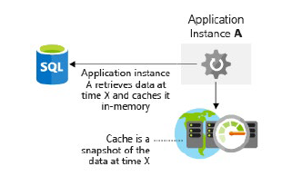
Caching
Azure Cache for Redis is a caching service on Azure that stores data in memory.
It's based upon the open-source Redis cache and is a fully managed service offering by Microsoft.
You select the performance tier that you require and configure your application to use the service.

Slide 12
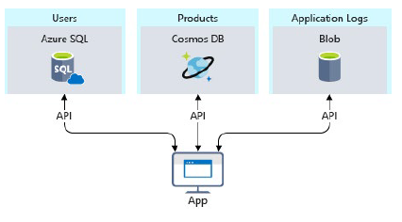
Polyglot Persistence
Consider an e-commerce example. You may store application assets in a blob store, product reviews and recommendations in a NoSQL store, and user profile or account data in a SQL database.

Slide 13
Performance Bottlenecks
Importance of requirements
In theory, we could keep improving scalability and performance further and further without end. At some point, however, more improvement is prohibitively expensive, difficult, and doesn't have enough business impact.
Performance monitoring options in Azure.
Azure Monitor
Azure Monitor provides a single management point for infrastructure-level logs and monitoring for most of your Azure services.
Log Analytics
With Log Analytics you can query and aggregate data across logs. This cross-source correlation can help you identify issues or performance problems that may not be evident when looking at logs or metrics individually.
Application performance management
Telemetry can include individual page request times, exceptions within your application, and even custom metrics to track business logic. This telemetry can provide a wealth of insight into apps.
DevOps & application performance
The idea behind DevOps is that we don't have development and infrastructure silos. Instead, they work together to effectively build, deploy, monitor, and maintain apps in streamlined process.
Notes:
In theory, we could keep improving scalability and performance further and further without end. At some point, however, more improvement is prohibitively expensive, difficult, and doesn't have enough business impact to be worthwhile.
Our non-functional requirements help us find that point. These particular requirements don't tell us what our app must do. Instead, they tell us what quality levels it must meet.
As examples, we can define these non-functional requirements to tell us:
How fast a transaction must return under a given load.
How many simultaneous connections we need to support before we start returning errors.
In the event of server failure, what is the maximum amount of time our application is allowed be down before a back-up is online.
Defining these requirements in advance of building your solution is critical to ensure that the application meets expectations but doesn't require more effort or expend more money than necessary. We can also plan our monitoring and operations rules around these non-functional requirements
One way we make performance part of our DevOps process is to carry out performance or load tests to validate that the application meets the non-functional requirements prior to a deployment into production
Azure Monitor provides us with a range of features including:
Azure alerts to proactively notify or take action on any breaches to metrics or activities arising.
Use Azure Dashboards to combine many monitoring sources into one view of our application

Slide 14
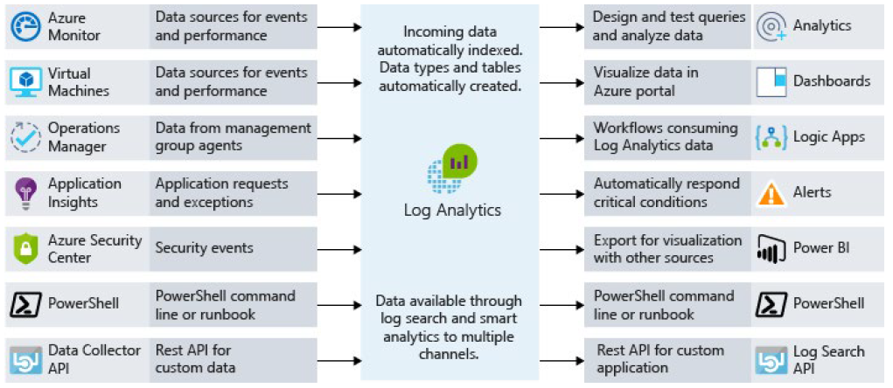
Log Analytics

Slide 15
High Availability
A highly-available service absorbs fluctuations in availability, load, and temporary failures in dependent services and hardware. The application remains online and available.
Determine the service-level agreement of your application
A service-level agreement (SLA) is an agreement between a service provider and a service consumer in which the service provider commits to a standard of service based on measurable metrics and defined responsibilities.
Evaluate the HA capabilities of the application
To evaluate the HA capabilities of your application, perform a failure analysis. Focus on single points of failure and critical components that would have a large impact on the application if they were unreachable, misconfigured, or started behaving unexpectedly.
Evaluate the HA capabilities of dependent applications
You'll need to understand not only your application's SLA requirements to your consumer, but also the provided SLAs of any resource that your application may depend on.

Slide 16
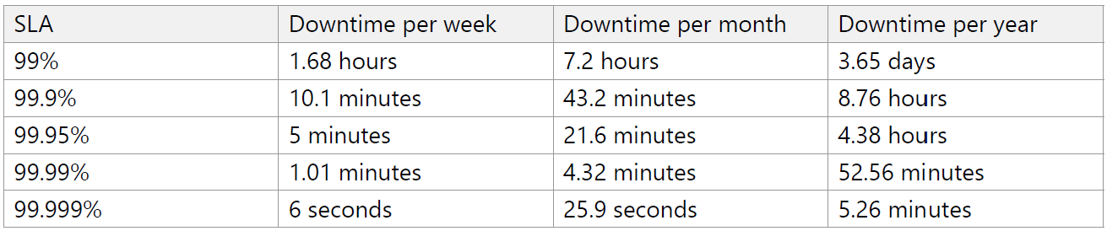
SLA Levels

Slide 17
Disaster Recovery
Disaster recovery is about recovering from high-impact events that result in downtime and data loss.
Create a disaster
recovery plan
Designing for
Disaster recovery
Testing disaster
recovery
A disaster recovery plan is a single document that details the procedures that are required to recover from data loss and downtime caused by a disaster and includes:
Risk assessment and process inventory
Recovery objectives
Detailed recovery steps
Disaster recovery is not an automatic feature. It must be designed, built, and tested, and should include the following:
Data recovery and replication
Process recovery
Azure Site Recovery
Service-specific features
Disaster recovery planning doesn't end once you have a completed plan in hand. Testing the plan is a crucial aspect of disaster recovery, to ensure that the directions and explanations are clear and up-to-date
Notes:
The word “disaster” often evokes thoughts of natural disasters and external events (earthquakes, floods, tropical storms, and so on) but many other kinds of disasters exist as well.
A failed deployment or upgrade can leave an app in an unrecognizable state.
Malicious hackers can encrypt or delete data and inflict other kinds of damage that take an app offline or eliminate some of its functionality.

Slide 18
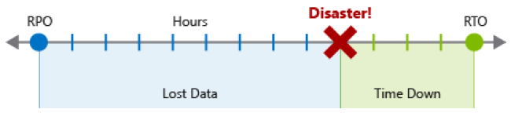
How to create a disaster recovery plan
Risk assessment and process inventory
Needs to consider every process that can't afford unlimited downtime, and every category of data that can't afford unlimited loss.
Recovery objectives
Recovery Point Objective (RPO): The maximum duration of acceptable data loss. RPO is measured in units of time, not volume: “30 minutes of data”, "four hours of data", and so on. RPO is about limiting and recovering from data loss, not data theft.
Recovery Time Objective (RTO): The maximum duration of acceptable downtime, where “downtime” needs to be defined by your specification. For example, if the acceptable downtime duration is eight hours in the event of a disaster, then your RTO is eight hours

Slide 19
Detailing recovery steps
Backups: How often they're created, where they're located, and how to restore data from them.
Data replicas: The number and locations of replicas, the nature and consistency characteristics of the replicated data, and how to switch over to a different replica.
Deployments: How deployments are executed, how rollbacks occur, and failure scenarios for deployments.
Infrastructure: On-premises and cloud resources, network infrastructure, and hardware inventory.
Dependencies: External services that are used by the application, including SLAs and contact information.
Configuration and notification: Flags or options that can be set to gracefully degrade the application, and services that are used to notify users of application impact.

Slide 20
Data recovery and replication
Azure Storage replication capabilities depend on the replication type of selected for the storage account. This replication can be local, zonal, or regional
Neither your application nor your operators interact with it directly. Failovers are automatic and transparent.
Azure SQL Database replication is automatic at a small scale, but recovery from a full Azure datacenter or regional outage requires geo-replication.
Setting up geo-replication is manual, but it’s a first-class feature of the service and well supported by documentation

Slide 21
Data recovery and replication
Cosmos DB is a globally distributed database system, and replication is central to its implementation.
Instead of configuring replication directly, you configure options related to partitioning and data consistency.
Automatically takes backups of your data at regular intervals, without affecting the performance or availability of the database operations.
Backups are stored separately in a storage service
Azure Synapse Analytics a snapshot creates a restore point you can leverage to recover or copy your data warehouse to a previous state. Since it is a distributed system, a snapshot consists of many files that are located in Azure storage.
Snapshots capture incremental changes from the data stored in your data warehouse.

Slide 22

Backup and Restore
Establish backup and restoration requirements
Azure backup and restore capabilities
Azure Backup
Azure Blob storage (archive tier)
Azure SQL Database
Azure App Service
Verify backups and test restore procedures
Neither replication nor backup are complete disaster recovery solutions on their own.

Slide 23

Lab: Designing for Scale and Resiliency

Slide 24
Lab overview
The students will explore a range of resiliency and scale issues that would have to be considered when defining a solution architecture for an organization. They will first look at how they will incorporate scale into a solution. They will follow this by looking into storage and database performance, and how solutions can be made highly available. Finally, the student will investigate the issue of disaster recovery.
Lab objectives
After completing this lab, you will be able to:
Adjust Workload Capacity by Scaling
Design for Optimized Storage and Database Performance
Design a Highly Available Solution
Incorporate Disaster Recovery into Architectures

Slide 25
Lab scenario
You have recently been hired as a senior data engineer at AdventureWorks and are working with a consultant and architects to design a resilience and scale approach for a cloud data platform solution that meets the organizations technical and business requirements.
Based on the case study about AdventureWorks, you have been asked by the board to produce a short report that address their concerns regarding the resilience and scaling of the services to meet with the websites ability to process sales and the customers demand for service. The report should confirm the concerns that has been raised, and your report should propose how the issues are to be dealt with.
You should also address the concerns of how the organization should maintain operations in the event of intermittent failures. It should also address a disaster recovery approach to ensure the data is protected.
At the end of this lab, you will have:
Adjust Workload Capacity by Scaling
Design for Optimized Storage and Database Performance
Design a Highly Available Solution
Incorporate Disaster Recovery into Architectures

Slide 26
Lab review
Exercise 1 – Have any availability or disaster recovery requirements been missed?
Exercise 2 – Was there any debate in the availability or disaster recovery options?
Exercise 3 – Are there technologies that could not provide any availability or disaster recovery?
Exercise 4 – Which availability or disaster recovery options are of importance to your own organization?

Slide 27
Lab 5 – Designing for Scale and Resiliency
Exercise 1 - Task 1: Adjust Workload Capacity by Scaling
Service to Scale | Justification | Scale Units
Azure SQL Database | For the Current Sales / Ordering system. Due to global expansion and data governance requirements, AdventureWorks will transition this system to better serve their customers and will be looking for global availability. | DTU
Azure Synapse | For the historical reporting system. The CTO expects that the same level of performance is also achieved in November and December when data volumes typically increase. | DWU
Azure Cosmos DB | Customer Service / Presales Bot. The customer service / presales chat bot needs to respond to requests for data in near real-time regardless of where the customer is located. | RTU

Slide 28
Lab 5 – Designing for Scale and Resiliency
Ex 2 - Task 1: Design for Optimized Storage and Database Performance
Service | Feature | Justification
Azure SQL Database | Dynamic scale | There is a requirement for Adventureworks to meet the demand during the months of November and December for the purchase of products during the holiday season demand.
Azure SQL Database | Elastic Database Transactions | This could be used to support the global expansion of the Current Sales / Ordering system.
Azure SQL Database | Read Scale-Out | Can be used for database read-only workloads. An example being that a read only database can be used as a data source to populate a data warehouse, or related staging environments such as a data lake
Azure Synapse | Scaling | The on-premises data warehouse server has been struggling to process the reporting data in a timely manner. In addition, there is a requirement to have the same level of performance achieved in November and December when data volumes typically increase.
Azure Synapse | Partitioning | A technique, when used in conjunction with scaling and PolyBase appropriately, can aid the speed at which data is loaded into a data warehouse.
Azure Synapse | PolyBase | A technology that can be used to aid the efficient loading of data into a data warehouse. This is further improved if the appropriate scaling and partitioning is used.
Azure Cosmos DB | Multi master | To deal with the global coverage of customer service, and the need to use a bot to handle requests in near real-time regardless of where the customer is located. Cosmos DB’s multi-master feature can help provide quick response times

Slide 29
Lab 5 – Designing for Scale and Resiliency
Exercise 3 - Task 1: Design a Highly Available Solution
Requirement | Service | Feature | Justification
To maintain the same level of availability for the mission critical Current Sales / Ordering system | SQL Database | Premium Tier | Premium and Business Critical service tiers leverage the Premium availability model, which integrates compute resources (SQL Server Database Engine process) and storage (locally attached SSD) on a single node. High availability is achieved by replicating both compute and storage to additional nodes creating a three to four-node cluster.
Customer Service / Presales requirement. The customer service / presales chat bot needs to respond to requests for data in near real-time regardless of where the customer is located. As requested by the organization. All services that are proposed should have a comprehensive business continuity. | Cosmos DB | Multi region, multiple write replication | To ensure high write and read availability, configure your Cosmos account to span at least two regions with multiple-write regions. This configuration will provide the highest availability, lowest latency, and best scalability for both reads and writes backed by SLAs. To learn more, see how to configure your Cosmos account with multiple write-regions.
Protection of staging data/predictive analytics source data in the Azure Data Lake Store meeting the requirement that all services that are proposed should have a comprehensive business continuity. | Data Lake Store Gen II | Read-access geo-redundant storage (RA-GRS) | Read-access geo-redundant storage (RA-GRS) maximizes availability for your storage account. RA-GRS provides read-only access to the data in the secondary location, in addition to geo-replication across two regions.
No availability feature | SQL Synapse | N/A | N/A
No availability feature | Azure Stream Analytics | N/A | N/A
No availability feature | Azure Data Factory | N/A | N/A

Slide 30
Lab 5 – Designing for Scale and Resiliency
Exercise 4 - Task 1: Incorporate Disaster Recovery into Architectures
Service | Disaster Recovery Approach | Justification
Data Lake Store Gen II | Read-access geo-redundant storage (RA-GRS) | In a DR strategy, it is also important to have data replicated to a different region using GRS or RA-GRS replication.
Cosmos DB | Automatic online backups | Azure Cosmos DB automatically takes a backup of your database every 4 hours and at any point of time, only the latest 2 backups are stored. However, if the container or database is deleted, Azure Cosmos DB retains the existing snapshots of a given container or database for 30 days.
SQL Database | Active geo-replication Auto-failover groups Geo-restore Zone-redundant databases | There are a wide range of options available for disaster recovery. Full details for at https://docs.microsoft.com/en-us/azure/sql-database/sql-database-disaster-recovery
SQL Synapse | Data warehouse snapshot Geo-backups | A data warehouse snapshot creates a restore point you can leverage to recover or copy your data warehouse to a previous state. SQL Data Warehouse takes snapshots of your data warehouse throughout the day creating restore points that are available for seven days. SQL Data Warehouse supports an eight-hour recovery point objective (RPO). You can restore your data warehouse in the primary region from any one of the snapshots taken in the past seven days. Geo-backup are performed once per day to a paired data center. The RPO for a geo-restore is 24 hours. You can restore the geo-backup to a server in any other region where SQL Data Warehouse is supported. A geo-backup ensures you can restore data warehouse in case you cannot access the restore points in your primary region.

Slide 31
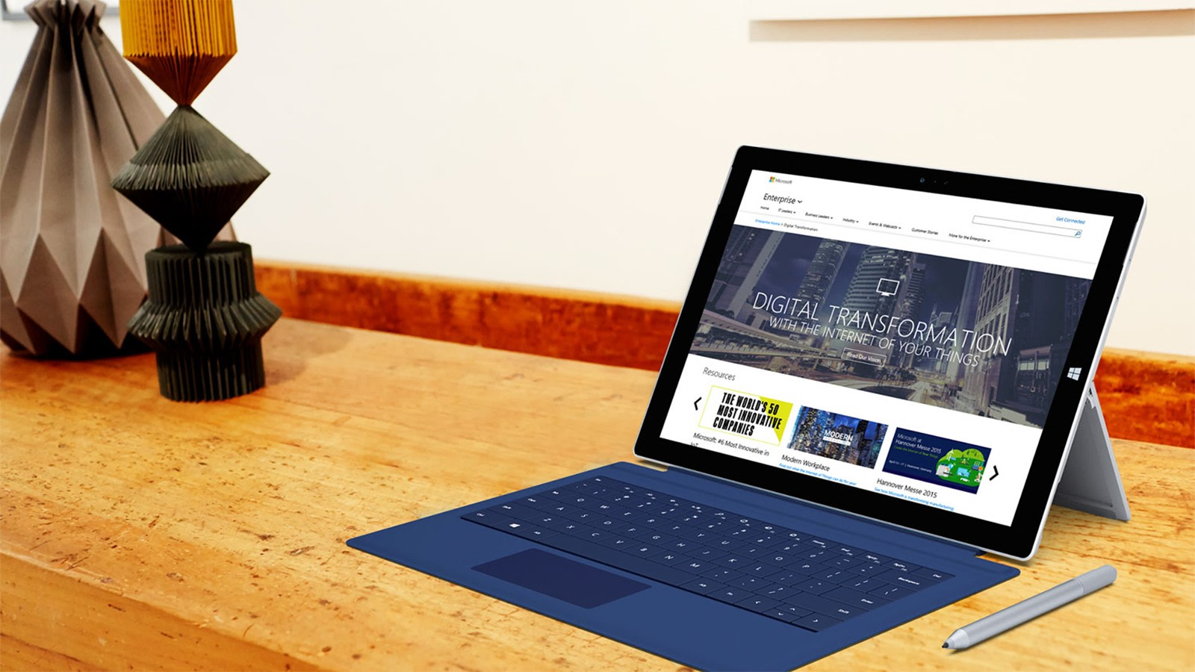
Next steps
Module Summary
In this module, you have learned about:
- Scaling Systems
- Optimizing Network Performance
- Optimizing Storage Performance
- Identifying Performance Bottlenecks
- High Availability
- Disaster Recovery
- Backup and Restore
After the course, you can use this holistic resilience and scalability checklist to review your architecture from a scalability standpoint

